Slide 2
Ontology and kw graph is built –
Probabilistic Markov field –

Slide 3
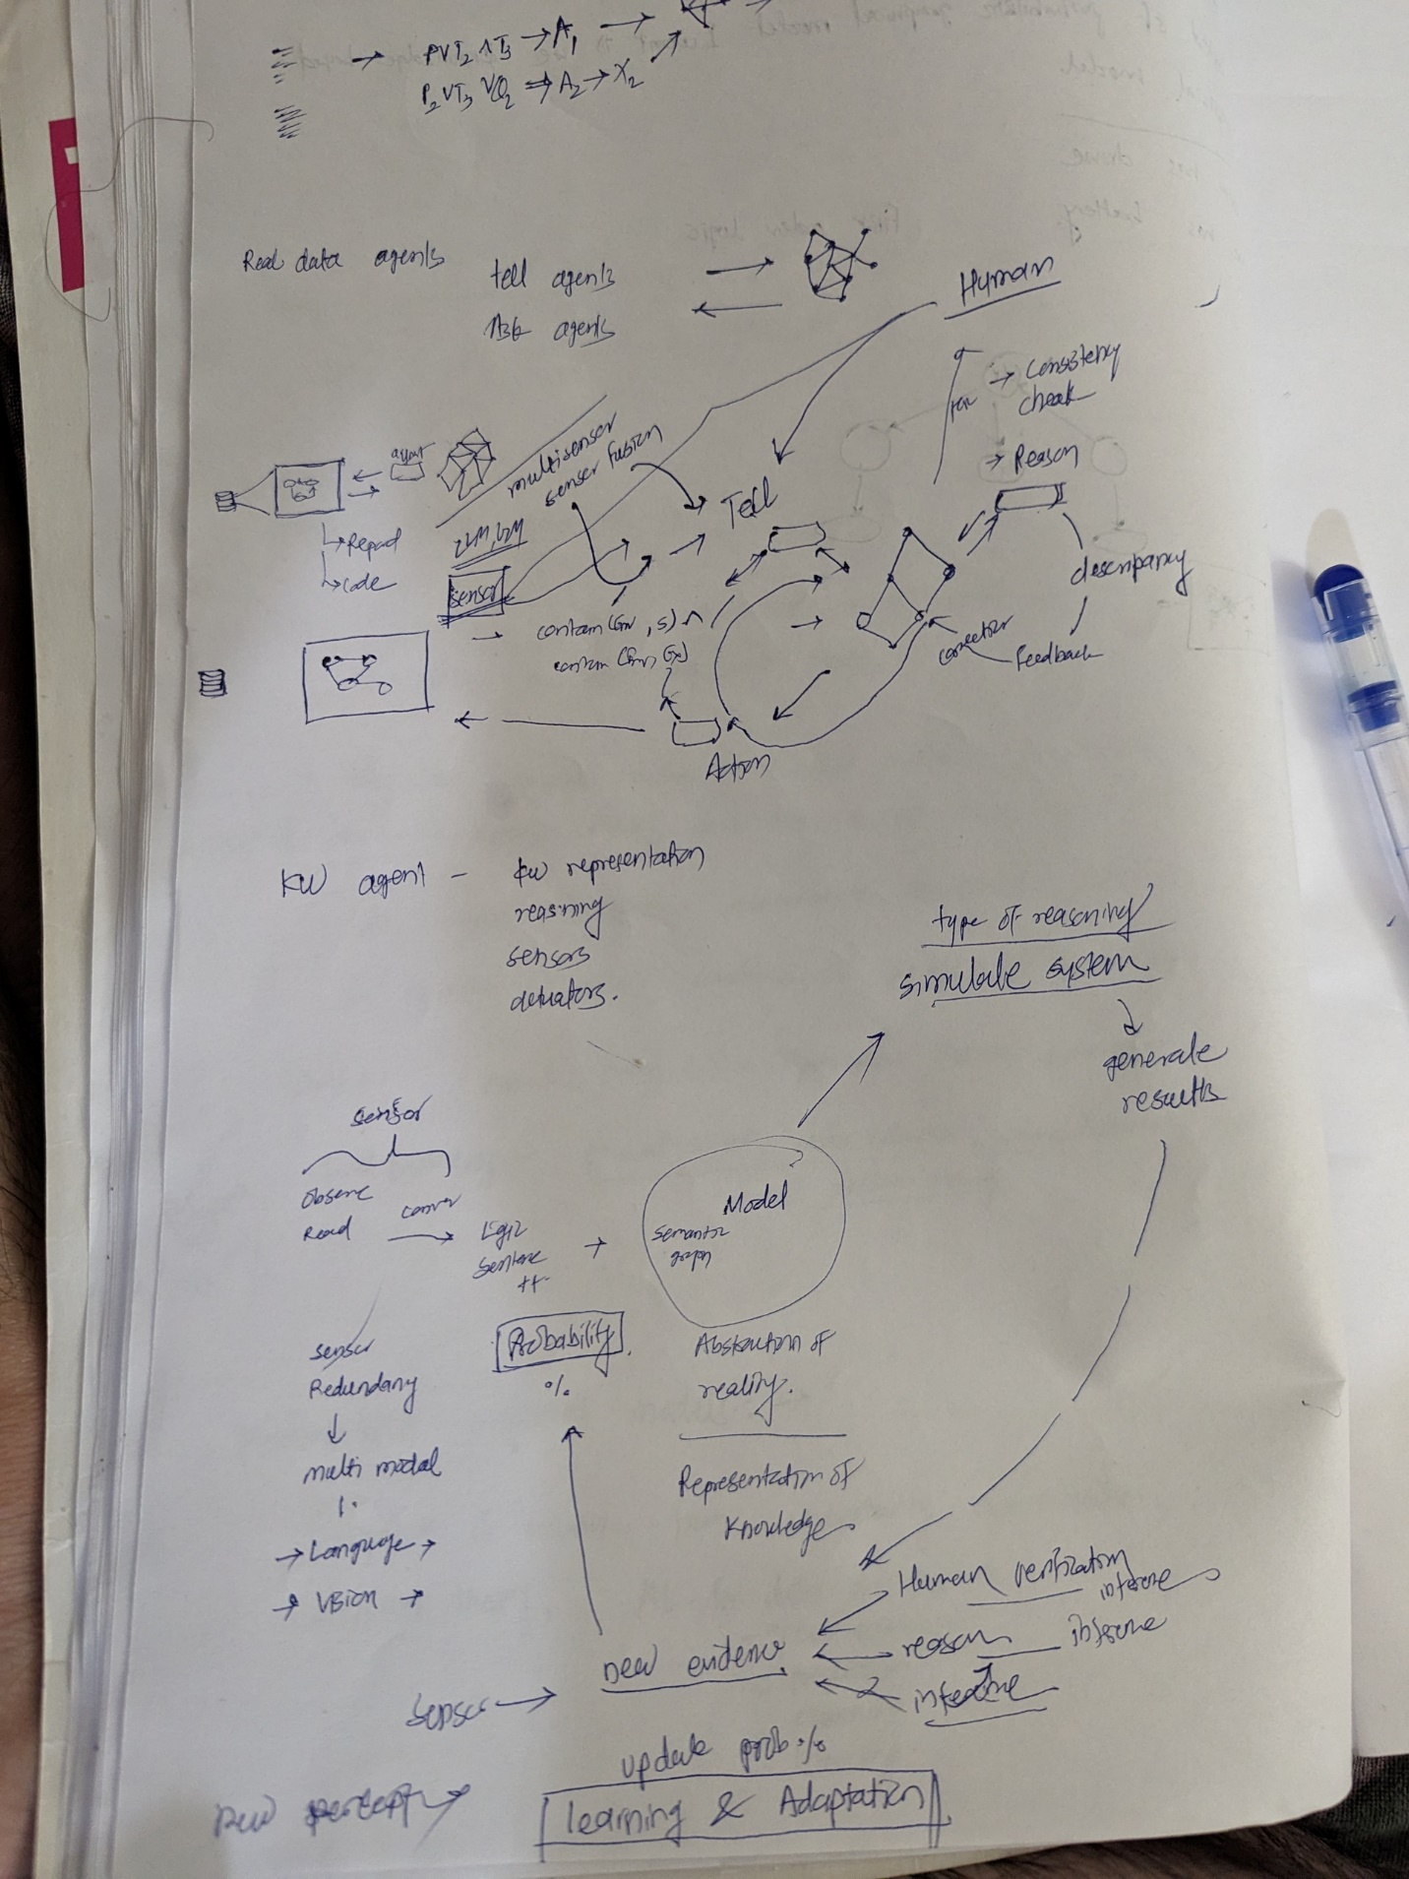
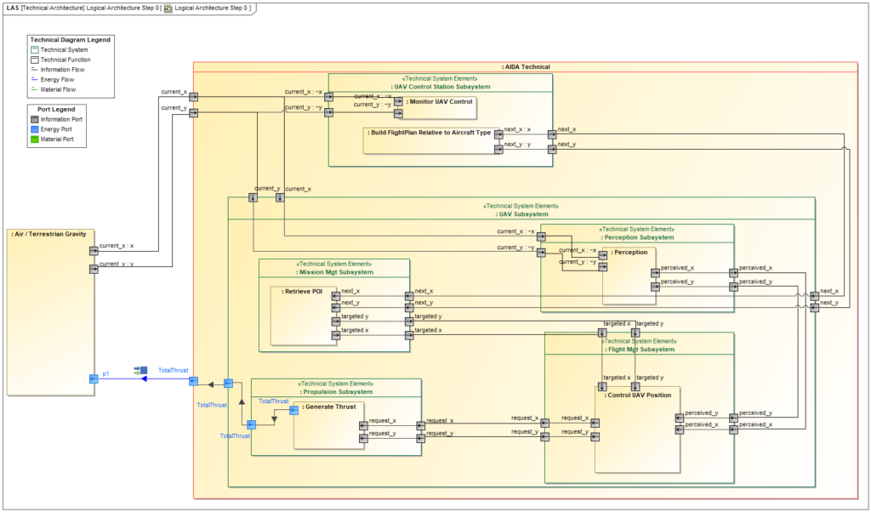
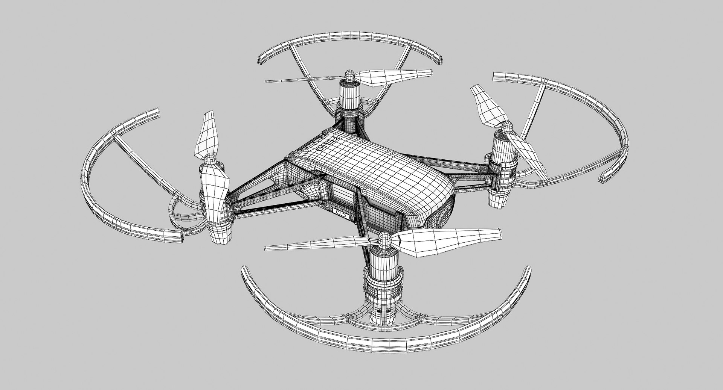
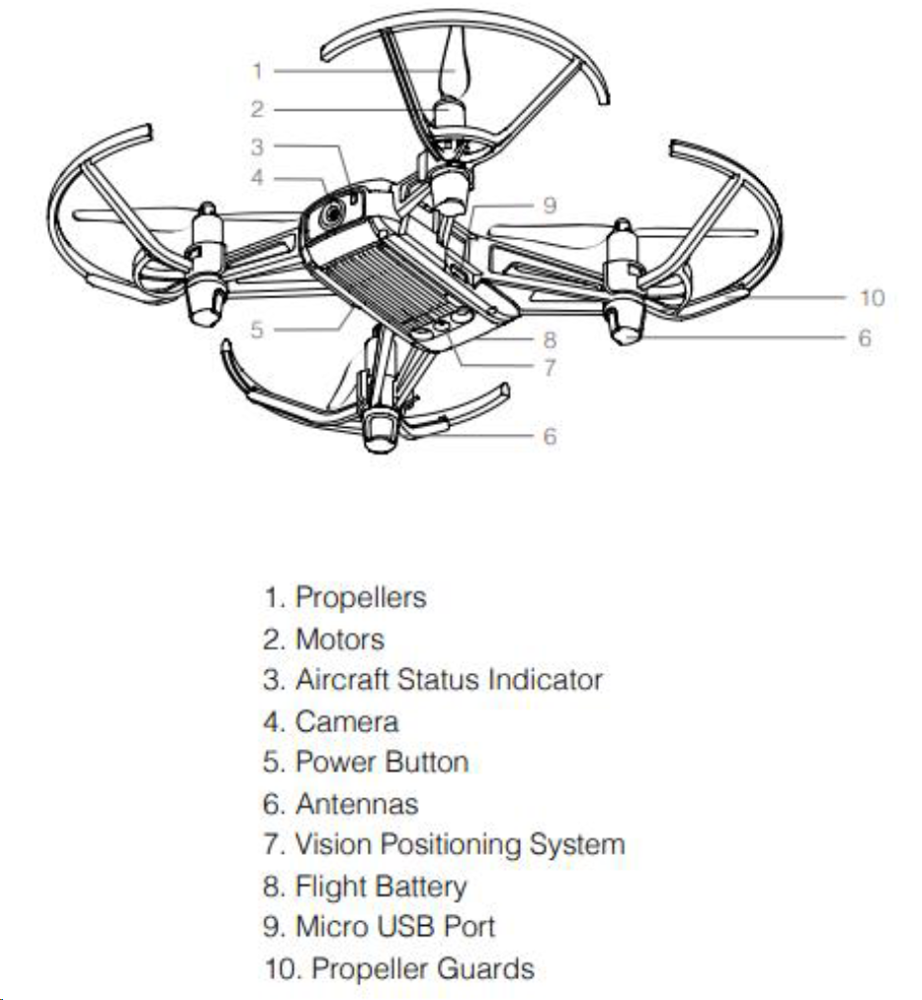
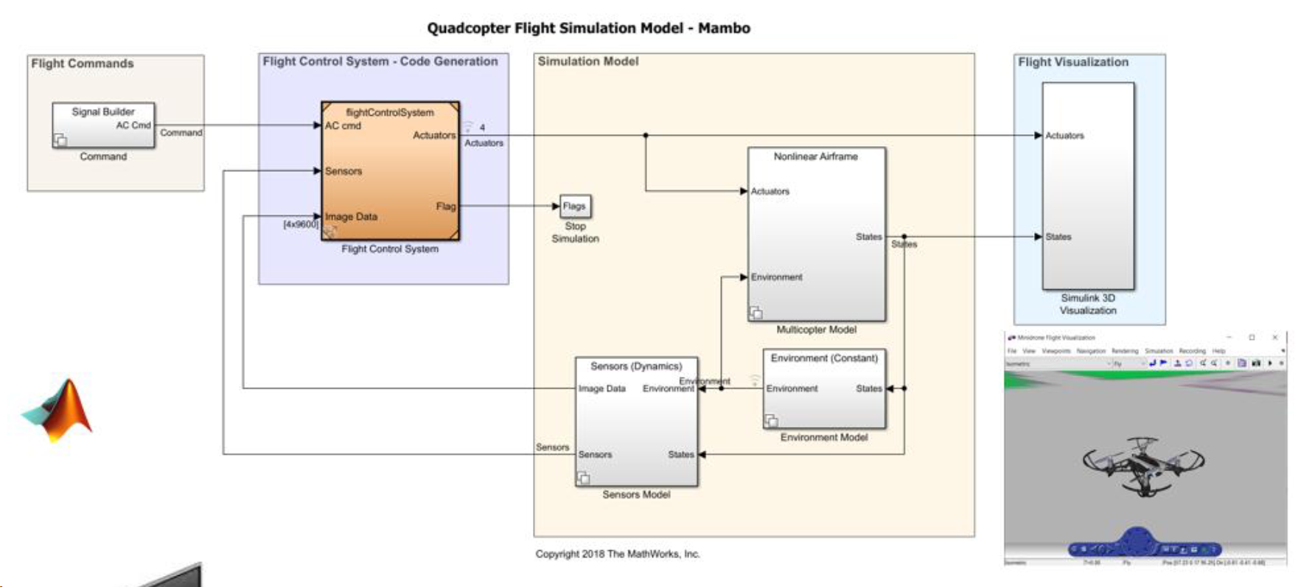
UI Test Automation Tool
Robotic Process Automation
Non-Visual Desktop Access
LLM
Segment Everything Model
Optical Character Recognition
ACT
ASK
Visual Generative Model
Actuator
Reasoner agent
Actuator
Sensor
Reasoner agent
Reasoner agent
Sensor
contains(Env, S) ∧ contains(Env, Ext)
∀x (selected(x) ∧ contains(S, x) → input(x, VM))
TELL
P(y)
P(y)
P(x)
P(x)
P(x)

Slide 4

Decision Support Questions
Humans
Abduction
Large Language Model
Induction
Optical Character Recognition
Robotic Process Automation
Reasoner
Deduction
Segment Everything Model
Non-Visual Desktop Access
Description Logic
Temporal Logic
probabilistic reasoning agent
Beliefs update with evidence
Visual Generative Model
UI Access
First Order Logic
Higher Order Logic
P(x4)
Multi Modal Percepts Agent
P(x2)
P(y2)
Traceability agent
Knowledge Representation
P(y7)
P(y3)
P(x1)
P(y1)
P(y6)
P(x3)
P(y8)
Reasoner
automated consistency checks
Multi Modal Actions Agent
Reasoner Ask Agent
P(y5)
P(y4)
P(x6)
P(x7)
Resolution Agents
Large Language Model
P(x5)
Optical Character Recognition
Robotic Process Automation
Knowledge-based Agent
Segment Everything Model
Non-Visual Desktop Access
Visual Generative Model
UI Access

Slide 5
Decision Support Questions
Agentic
Reflection
Tool use
Planning
collaboration
Humans
Abduction
Large Language Model
Induction
Cause - effect
Optical Character Recognition
Robotic Process Automation
Modal Logic
Reasoner
Deduction
Segment Everything Model
Non-Visual Desktop Access
Description Logic
Temporal Logic
probabilistic reasoning agent
Beliefs update with evidence
Visual Generative Model
UI Access
First Order Logic
Higher Order Logic
P(x4)
Multi Modal Percepts Agent
P(x2)
P(y2)
Traceability agent
enable audit trails and provenance
Formal Knowledge Representation Agent
P(y7)
P(y3)
P(x1)
P(y1)
P(y6)
P(x3)
P(y8)
Reasoner
automated consistency checks
Multi Modal Actions Agent
Reasoner Action Agent
P(y5)
P(y4)
System Control Model
P(x6)
P(x7)
Resolution Agents
Large Language Model
Energy
P(x5)
Optical Character Recognition
Robotic Process Automation
intelligence
Ontology-Based Dynamic Knowledge Graph
Knowledge-based Agent
Segment Everything Model
Non-Visual Desktop Access
boundary
Online Learning
Visual Generative Model
UI Access
Semantic adequacy
entropy
Relations – non linear , linear relations
truth maintenance techniques
Agentic Percept, reasoning and Action Systems:
How to minimizing information loss and maximizing the value extracted
information-theoretic concepts such as entropy and divergence can be applied to assess the quality and fidelity of digital twin models, helping to quantify the information captured by the models and identify areas for improvement. create systems that effectively handle the vast amounts of data generated by real-world assets and processes while minimizing information loss and maximizing the value extracted from the data.
Distributed Control for multiple agents – in agentic case: Distributed control theory deals with the coordination and control of multi-agent or networked systems, where multiple subsystems interact and collaborate to achieve a common goal.
Techniques like consensus algorithms and cooperative control enable the synchronization and coordination of distributed components in a system.
In the context of digital twins, distributed control can be used to manage the interactions and data exchange between multiple digital twins representing different subsystems or components of a larger system.

Slide 6
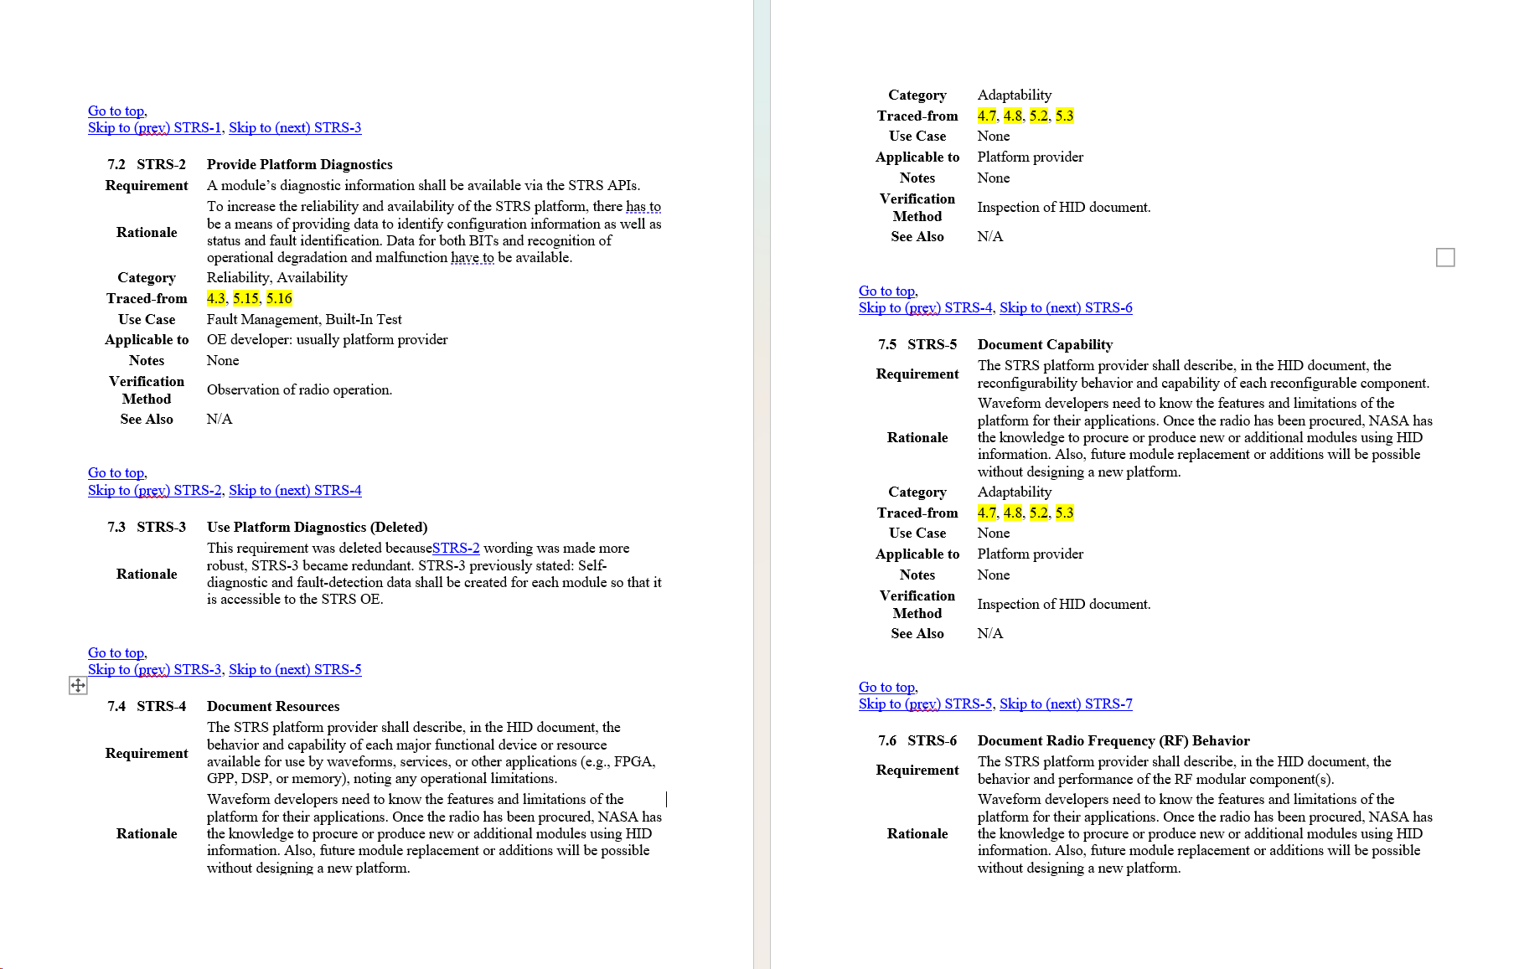
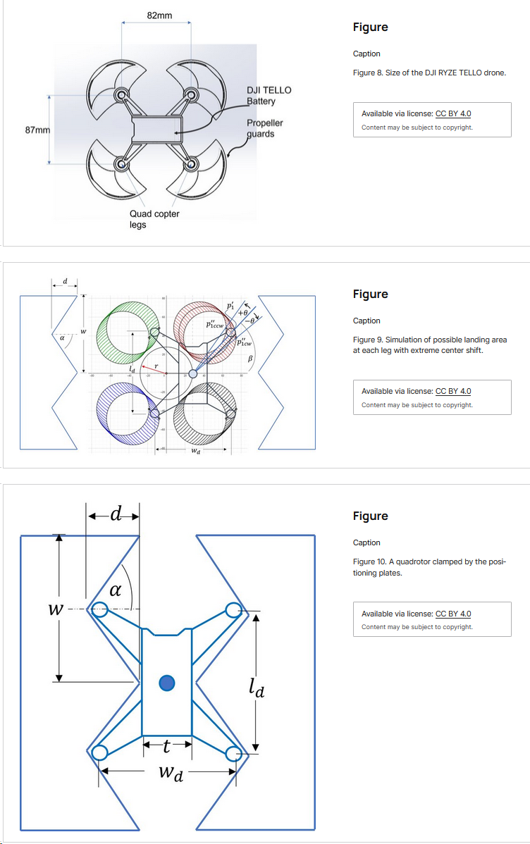
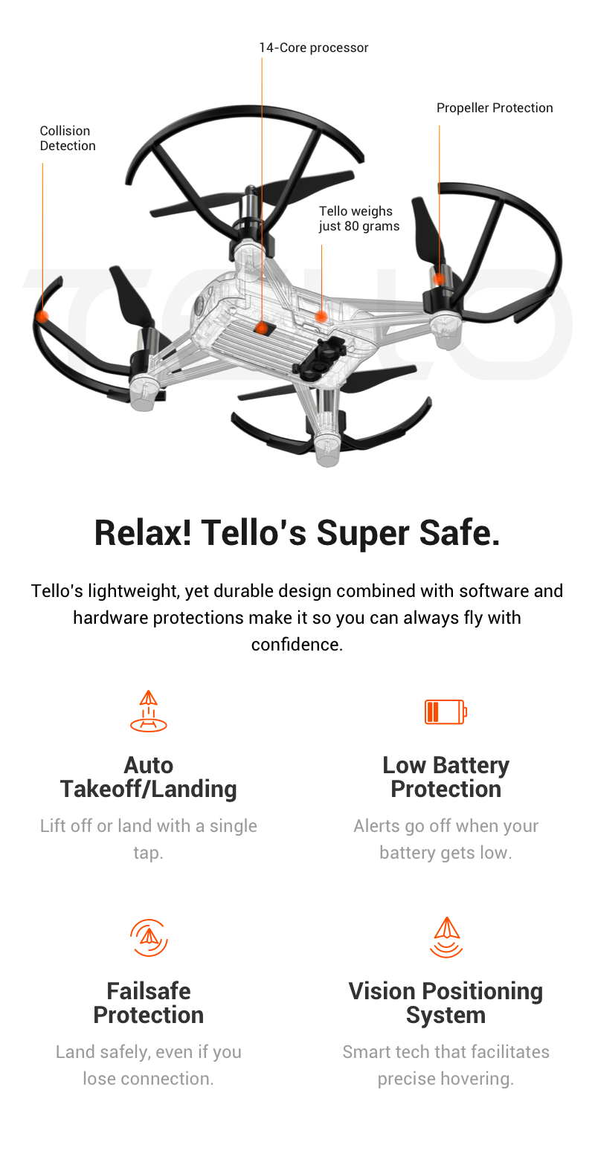
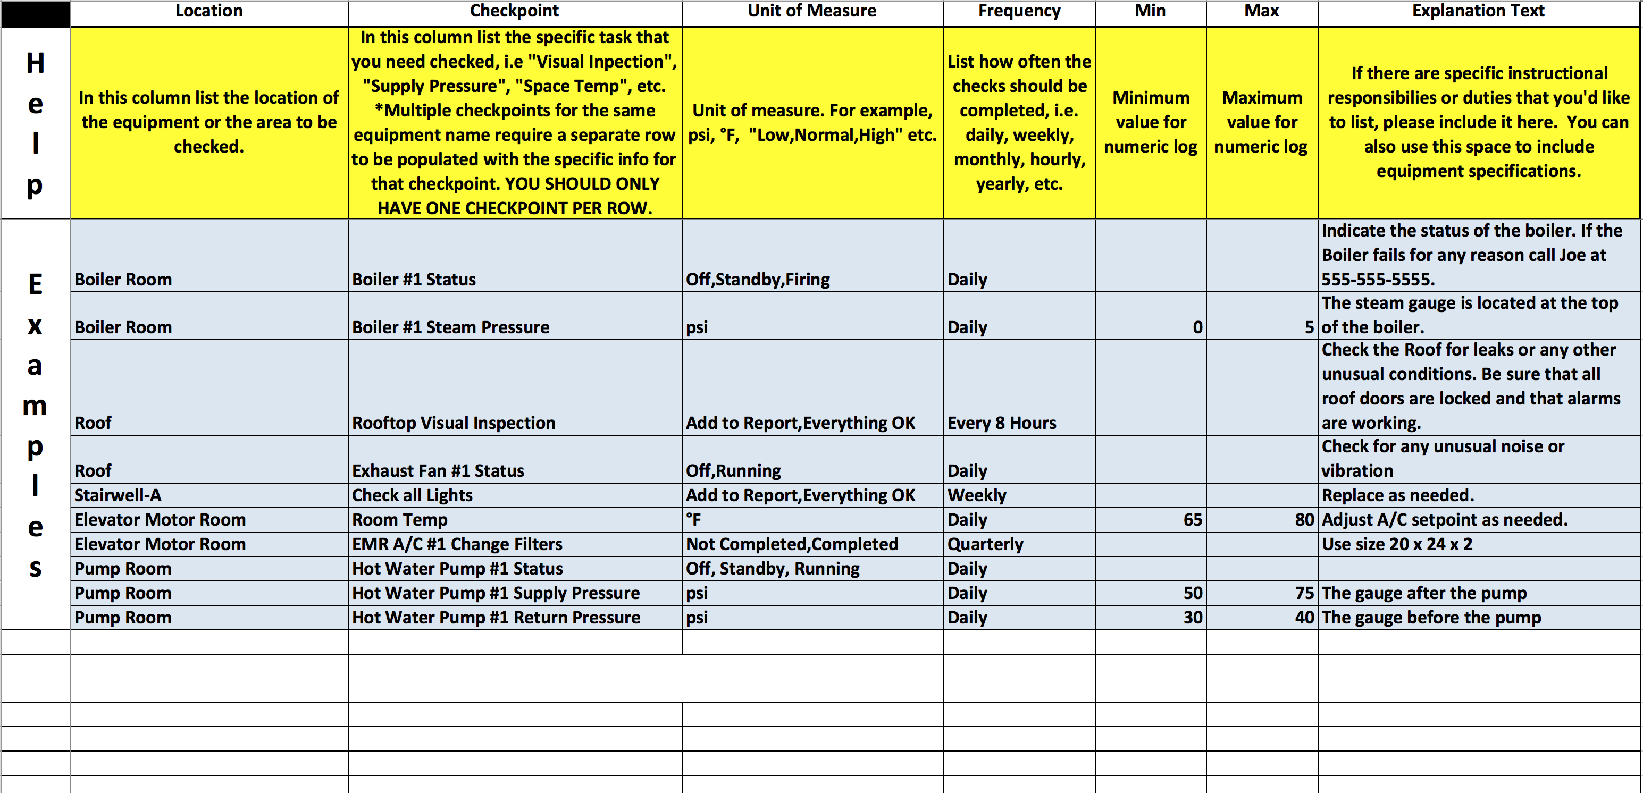
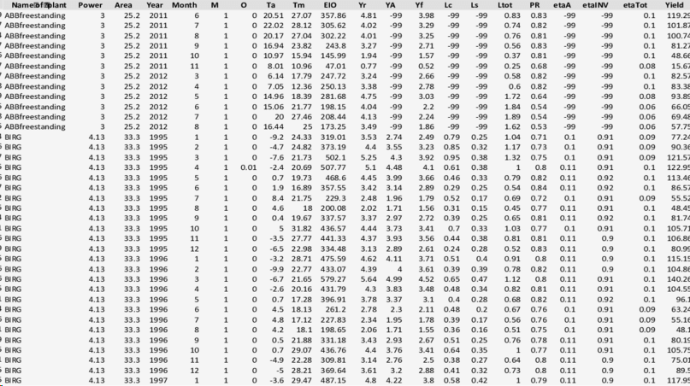
Decision Support Questions
Humans
Abduction
Large Language Model
Induction
Optical Character Recognition
Robotic Process Automation
Modal Logic
Reasoner
Deduction
Segment Everything Model
Non-Visual Desktop Access
Description Logic
Temporal Logic
probabilistic reasoning agent
Beliefs update with evidence
Visual Generative Model
UI Access
First Order Logic
Higher Order Logic
P(x4)
Multi Modal Percepts Agent
P(x2)
P(y2)
Traceability agent
Enable audit trails and provenance
Formal Knowledge Representation Agent
P(y7)
P(y3)
P(x1)
P(y1)
P(y6)
P(x3)
P(y8)
Knowledge-based Agent
Automated consistency checks
Multi Modal Actions Agent
Reasoner Action Agent
P(y5)
P(y4)
System Control Model
P(x6)
P(x7)
Large Language Model
P(x5)
Optical Character Recognition
Robotic Process Automation
Ontology-Based Dynamic System Model
Segment Everything Model
Non-Visual Desktop Access
Visual Generative Model
UI Access
System Requirement Specifications
Design Specification Documents
Maintenance Logs
Operational Data

Slide 7
Large Language Model
Robotic Process Automation
Modal Logic
System Control Model
Segment Everything Model
Non-Visual Desktop Access
Description Logic
Temporal Logic
Vision Generative Model
UI Access
First Order Logic
Higher Order Logic
P(x4)
Multi Modal Percepts Agent
P(x2)
P(y2)
Formal Knowledge Representation Agent
P(y7)
P(y3)
P(x1)
P(y1)
P(y6)
P(x3)
P(y8)
System Requirement Specifications
Multi Modal Actions Agent
Reasoner Action Agent
P(y5)
P(y4)
P(x6)
P(x7)
P(x5)
System Model
P(y2)
P(x4)
P(x2)
P(y7)
P(y3)
P(x4)
Mid-Level Ontology
P(x1)
P(y1)
P(y6)
P(x3)
P(y8)
P(x2)
P(y2)
System Requirement Specifications
P(y5)
P(x6)
P(y4)
P(x7)
P(x1)
P(y1)
P(y7)
P(y3)
P(x5)
P(y6)
P(x3)
P(y8)
Core Ontology
Requirements Engineering Domain Ontology
P(y5)
P(x6)
P(y4)
P(x7)
P(x5)
P(x4)
P(x2)
P(y2)
P(x1)
P(y1)
P(y7)
P(y3)
P(x4)
P(y6)
P(x3)
P(y8)
P(y5)
P(x6)
P(y4)
P(x2)
P(y2)
P(x5)
P(x7)
P(x1)
P(y1)
P(y7)
P(y3)
P(y6)
P(x3)
P(y8)
Maintenance Logs
P(y5)
P(x6)
P(y4)
P(x7)
P(x5)
Maintenance Domain Ontology

Slide 8
Large Language Model
Robotic Process Automation
Modal Logic
System Control Model
Segment Everything Model
Non-Visual Desktop Access
Description Logic
Temporal Logic
Vision Generative Model
UI Access
First Order Logic
Higher Order Logic
P(x4)
Multi Modal Percepts Agent
P(x2)
P(y2)
Formal Knowledge Representation Agent
P(y7)
P(y3)
P(x1)
P(y1)
P(y6)
P(x3)
P(y8)
System Requirement Specifications
Multi Modal Actions Agent
Reasoner Action Agent
P(y5)
P(y4)
P(x6)
P(x7)
P(x5)
System Model

Slide 9

Human Interaction
P(x4)
Beliefs update with evidence
Knowledge Sources
Knowledge Sources
Knowledge Sources
P(x2)
P(y2)
Enable audit trails and provenance
Multi-Modal Perception
Formal Knowledge Representation
P(y7)
P(y3)
Physical System
P(x1)
P(y1)
P(y6)
P(x3)
P(y8)
Reasoning
Consistency checks
Physical System
Multi Modal Action System
Physical System
P(y5)
P(y4)
Planning
P(x6)
P(x7)
Coordination
P(x5)
System Model

Slide 10
P(x4)
Knowledge Sources
Digital Artifacts
Knowledge Sources
P(y2)
Physical System
Knowledge Sources
Multi-Modal Perception
Formal Knowledge Representation
P(x2)
P(y7)
P(y3)
Deductive Reasoning
Environment
P(x1)
P(y1)
P(y6)
P(x3)
P(y8)
Reasoning
Abductive Reasoning
P(y5)
P(x6)
P(y4)
Inductive Reasoning
P(x7)
Human Interaction
P(x5)
System Model
Multi Modal Action System
Beliefs update with evidence
Enable audit trails and provenance
Consistency checks

Slide 11
P(x4)
Knowledge Sources
Digital Artifacts
Knowledge Sources
P(y2)
Physical System
Knowledge Sources
Multi-Modal Perception
Formal Knowledge Representation
P(x2)
P(y7)
P(y3)
Deductive Reasoning
Environment
P(x1)
P(y1)
P(y6)
P(x3)
P(y8)
Reasoning
Abductive Reasoning
P(y5)
P(x6)
P(y4)
Inductive Reasoning
P(x7)
Human Interaction
P(x5)
System Model
Multi Modal Action System
Beliefs update with evidence
Enable audit trails and provenance
Consistency checks

Slide 12
P(x4)
Physical Systems
Generative AI Agents
Generative AI Agents
P(x2)
P(y2)
Digital Assets
Multi-Modal Perception
Formal Knowledge Representation
P(y7)
P(y3)
Generative AI Agents
Generative AI Agents
Engineering Tools
P(x1)
P(y1)
P(y6)
P(x3)
P(y8)
Reasoning
Human Interaction
P(y5)
P(x6)
P(y4)
P(x7)
P(x5)
Generative AI Agents
Digital Twin System Model
Multi Modal Action
Beliefs update with evidence
Enable audit trails and provenance
Consistency checks

Slide 13
Digital Twin System Model
P(x4)
Physical Systems
Generative AI Agents
P(x2)
P(y2)
Digital Assets
Multi-Modal Perception
P(y7)
P(y3)
Generative AI Agents
Generative AI Agents
Software Tools
P(x1)
P(y1)
P(y6)
P(x3)
P(y8)
Reasoning
Human Interaction
P(y5)
P(x6)
P(y4)
P(x7)
P(x5)
Generative AI Agents
Formal Knowledge Representation
Multi Modal Action
Planning & Coordination
Generative AI Agents
Beliefs update with evidence
Enable audit trails and provenance
Consistency checks

Slide 14
Analysis
Digital Twin
Actions
Perception
Upgraded System
Fielded System
Digital Twin System Model
Generative AI Agents
Analysis
Reasoning
Formal Knowledge Representation
Coordinate
Generate
Generative AI Agents
Generative AI Agents
Act
Perceive
Fielded System
Upgraded System

Slide 15
Analysis
Digital Twin
Actions
Perception
Upgraded System
Fielded System
Fielded System
Upgraded System
Act
Knowledge Acquisition
Generative AI Agents
Generative AI Agents
Formal Knowledge Representation
Reason
Generative AI Agents
Digital Twin System Model

Slide 16
P(x4)
Physical Systems
Generative AI Agents
Generative AI Agents
P(x2)
P(y2)
Digital Assets
Multi-Modal Perception
Formal Knowledge Representation
P(y7)
P(y3)
Generative AI Agents
Generative AI Agents
Engineering Tools
P(x1)
P(y1)
P(y6)
P(x3)
P(y8)
Reasoning
Human Interaction
P(y5)
P(x6)
P(y4)
P(x7)
P(x5)
Generative AI Agents
Digital Twin System Model Based on Ontologies
Multi Modal Action
Generative AI Agents
Planning and Coordination
Beliefs update with evidence
Enable audit trails and provenance
Consistency checks

Slide 17
Human Interaction
P(x4)
Knowledge Sources
Digital Artifacts
Knowledge Sources
P(y2)
Physical System
Knowledge Sources
Multi-Modal Perception
Formal Knowledge Representation
P(x2)
P(y7)
P(y3)
Environment
P(x1)
P(y1)
P(y6)
P(x3)
P(y8)
Reasoning
Deductive Solvers
P(y5)
P(x6)
P(y4)
P(x7)
P(x5)
System Model
Coordination
Multi Modal Action System
Planning
Vision Model
Language Model
UI Access
Beliefs update with evidence
Enable audit trails and provenance
Enable audit trails and provenance
Consistency checks
Abductive Reasoning

Slide 18
Human Interaction
P(x4)
Knowledge Sources
Digital Artifacts
Knowledge Sources
P(y2)
Physical System
Knowledge Sources
Multi-Modal Perception
Formal Knowledge Representation
P(x2)
P(y7)
P(y3)
Environment
P(x1)
P(y1)
P(y6)
P(x3)
P(y8)
Reasoning
P(y5)
P(x6)
P(y4)
P(x7)
P(x5)
System Model
Multi Modal Action System
Vision Model
Language Model
UI Access

Slide 19
Humans
Answering Decision Support Questions
Knowledge Sources
P(x4)
Beliefs update with evidence
Knowledge Sources
Knowledge Sources
P(x2)
P(y2)
Enable audit trails and provenance
Multi-Modal Perception
Formal Knowledge Representation
P(y7)
P(y3)
Multi Modal Action
P(x1)
P(y1)
P(y6)
P(x3)
P(y8)
Reasoning
Consistency checks
P(y5)
P(x6)
P(y4)
Planning
P(x7)
Coordination
P(x5)
System Model

Slide 20
KW
Percept
Act
KW
Percept
Act

Slide 21
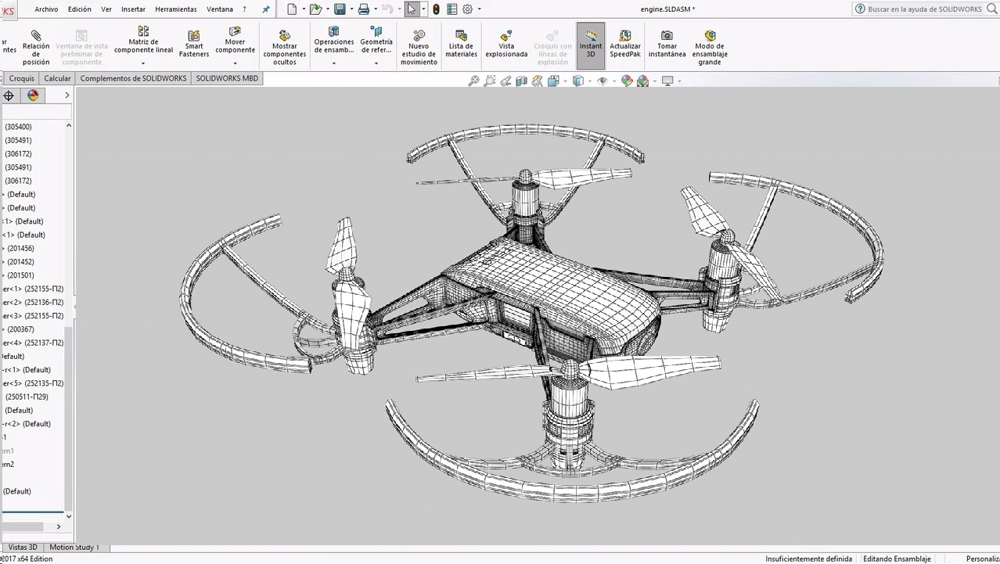

Decision Support Questions
Humans
Abduction
Large Language Model
Induction
Optical Character Recognition
Robotic Process Automation
Reasoner
Deduction
Segment Everything Model
Non-Visual Desktop Access
Description Logic
Temporal Logic
probabilistic reasoning agent
Beliefs update with evidence
Visual Generative Model
UI Access
First Order Logic
Higher Order Logic
P(x4)
Multi Modal Percepts Agent
P(x2)
P(y2)
Traceability agent
Formal Knowledge Representation Mechanism
P(y7)
P(y3)
P(x1)
P(y1)
P(y6)
P(x3)
P(y8)
Reasoner
automated consistency checks
Multi Modal Actions Agent
Reasoner Ask Agent
P(y5)
P(y4)
System Control Model
P(x6)
P(x7)
Resolution Agents
Large Language Model
P(x5)
Optical Character Recognition
Robotic Process Automation
Ontology-Based Dynamic Knowledge Graph
Knowledge-based Agent
Segment Everything Model
Non-Visual Desktop Access
Online Learning
Visual Generative Model
UI Access
Decision Support Questions
Humans
Abduction
Large Language Model
Induction
Optical Character Recognition
Robotic Process Automation
Reasoner
Deduction
Segment Everything Model
Non-Visual Desktop Access
Description Logic
Temporal Logic
probabilistic reasoning agent
Beliefs update with evidence
Visual Generative Model
UI Access
First Order Logic
Higher Order Logic
P(x4)
Multi Modal Percepts Agent
P(x2)
P(y2)
Traceability agent
Knowledge Representation
P(y7)
P(y3)
P(x1)
P(y1)
P(y6)
P(x3)
P(y8)
Reasoner
automated consistency checks
Multi Modal Actions Agent
Reasoner Ask Agent
P(y5)
P(y4)
System Control Model
P(x6)
P(x7)
Resolution Agents
Large Language Model
P(x5)
Optical Character Recognition
Robotic Process Automation
Ontology-Based Dynamic Knowledge Graph
Knowledge-based Agent
Segment Everything Model
Non-Visual Desktop Access
Online Learning
Visual Generative Model
UI Access

Slide 22
Percept System

